Slide 1
FAMILY IN THE MEDIA

Slide 2
Focusing Particularly on Full House
and Fuller House

Slide 3
Summary of the Sitcoms
FULL HOUSE
A widow father(Danny) of three girls (DJ, Stephanie, and Mitchelle)
Invites his best friend (Joey) and Brother-in-law (Jesse) to help
We see them grow up and raise the girls
1987-95
FULLER HOUSE
The Reboot
DJ is a recently widowed mother of three boys (Jackson, Max, and Tommy)
Has her sister (Stephanie) and best friend (Kimmy) move in to help with her children
We see them experience life together
2016-2020
https://www.youtube.com/watch?v=N9y61eSRPM8&ab_channel=Netflix

Slide 4
The Family tree

Slide 5
The family tree

Slide 6
THE FAMILY
Nuclear Family
Extended Family
Changing the meaning of family

Slide 7
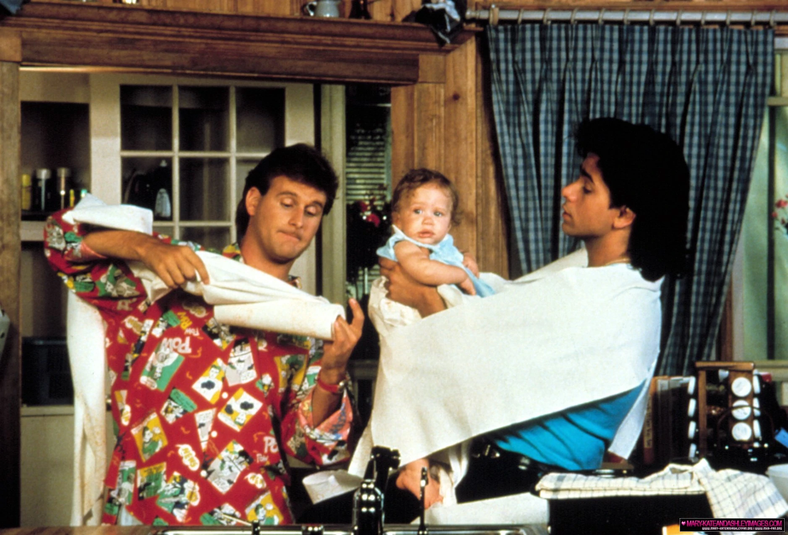
PARENTHOOD
FULL HOUSE
Jesse and Joey’s lack of knowledge for children
Where Danny lacks, Joey or Jesse will fulfill the role
Rebecca “Becky”

Slide 8
Parenthood
FULLER HOUSE
Stephanie’s lack of knowledge for children but yet still better than her uncle and Joey
Adoption
Surrogacy
Normal

Slide 9
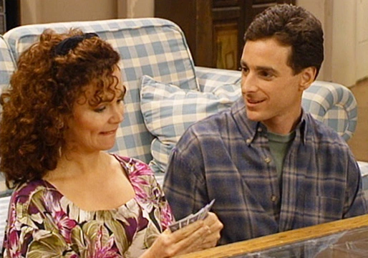
Social circle
FULL HOUSE
Should be dating again
FULLER HOUSE
Encouragement from her sister and Kimmy to date again
Is a mom

Slide 10
Traditions
They have dinner together as a family
Thanksgiving Episodes
Many things happen in the kitchen

Slide 11
Other key things to note
They included friendships
They made one person’s problem the entire families
Despite the fact there was no woman or male role model the show still have someone filling that role
Lack of minority
https://youtu.be/mN2P1Nz5ir8 (end at 1:14)

Slide 12
References
https://screenrant.com/fuller-house-season-6-story-details-stephanie/
https://variety.com/2016/tv/news/fuller-house-renewed-season-2-netflix-1201720261/
https://www.rottentomatoes.com/tv/fuller_house
https://www.pinterest.ca/pin/465911523949282804/
https://www.cnn.com/2020/04/09/entertainment/full-house-cast-quarantine/index.html
https://www.looper.com/215165/the-ending-of-fuller-house-the-farewell-season-explained/
https://fullhouse.fandom.com/wiki/Our_Very_First_Show
https://fuller-house.fandom.com/wiki/Our_Very_First_Show,_Again
https://tvline.com/2015/06/11/fuller-house-spoilers-danny-wife-kimmy-ex-husband/
https://www.ign.com/articles/2016/12/13/fuller-house-season-2-review
https://www.vogue.com/article/full-house-set-fuller-house-netflix

